Slide 1
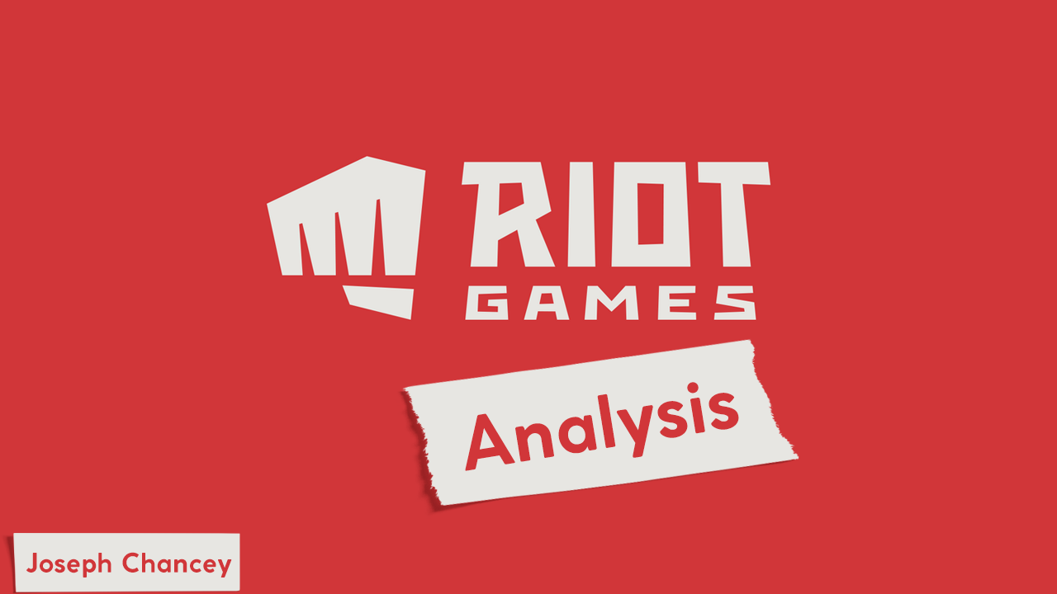

Slide 2
Objective
Hypothesis:
The map in League of Legends is one-sided, in favor of the blue side.
Questions that came up:
Do kills have the same significance as objectives?
Average game length?
Does Gold income peak at a certain point in the match?

Slide 3
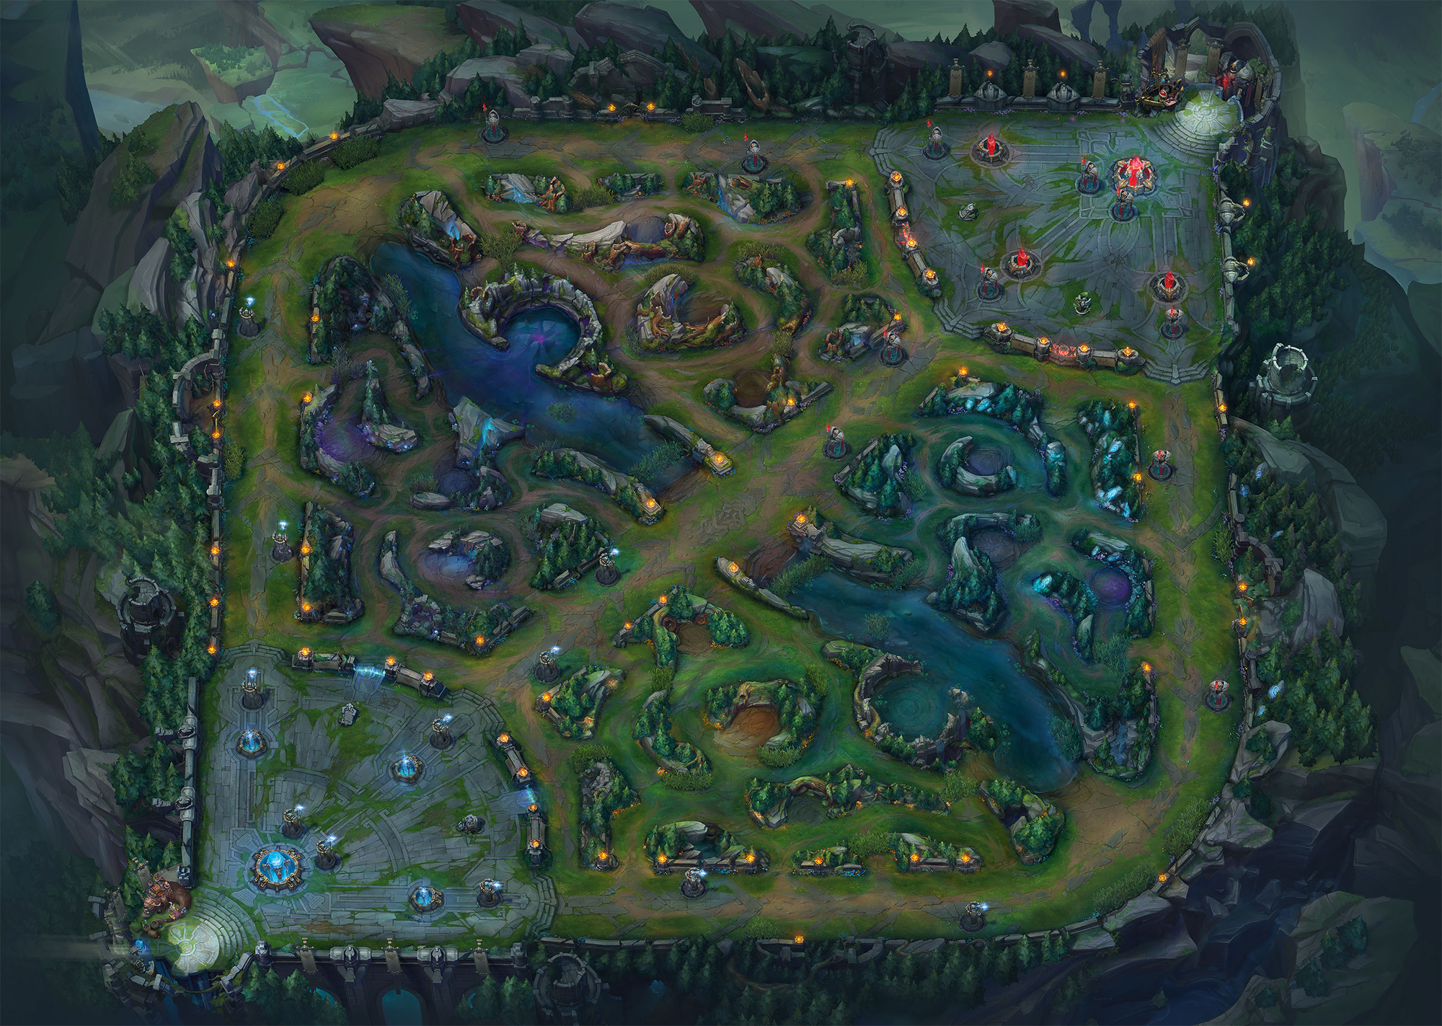

Slide 4
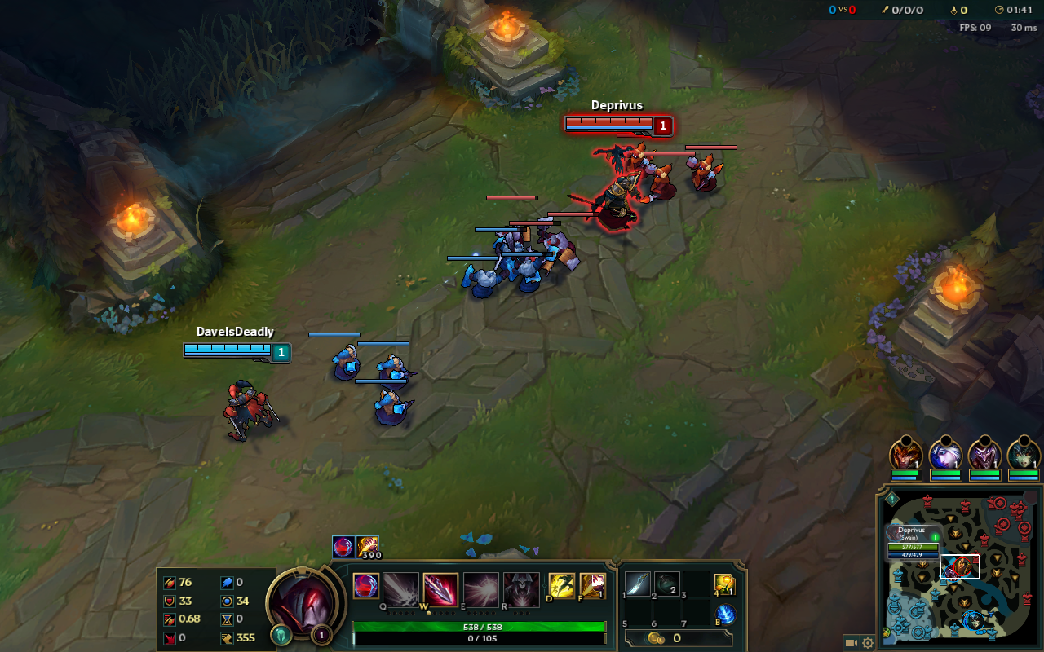

Slide 5
Process
Import
Clean
DataFrame Teams and Win/Loss
Run .corr() & .describe() & .mean() & .std() etc…
Plot
Review

Slide 6
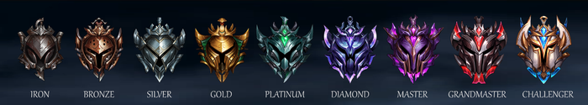
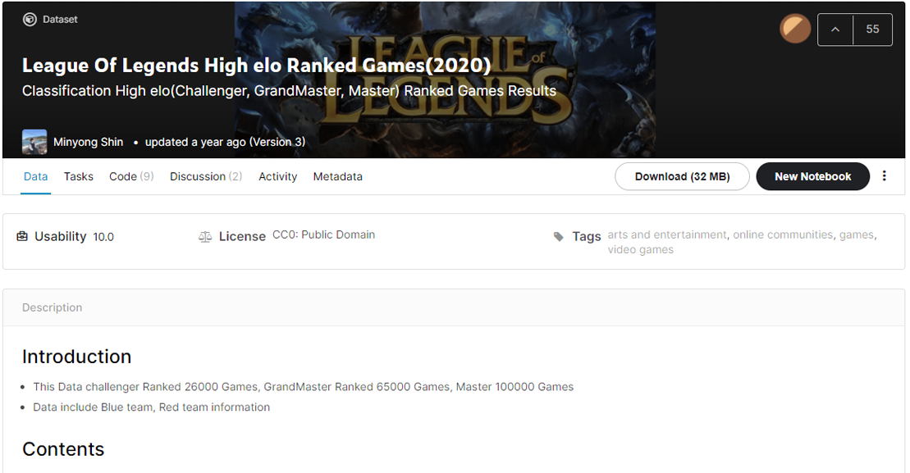
Data

Slide 7
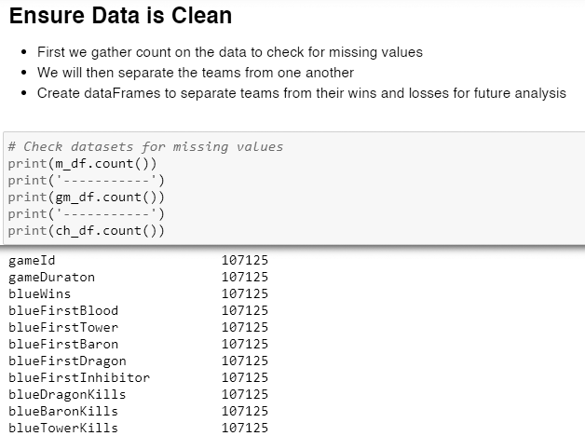
Cleaning – Missing Values
Check for missing values.
.count()
.info()
DataTypes were good.

Slide 8
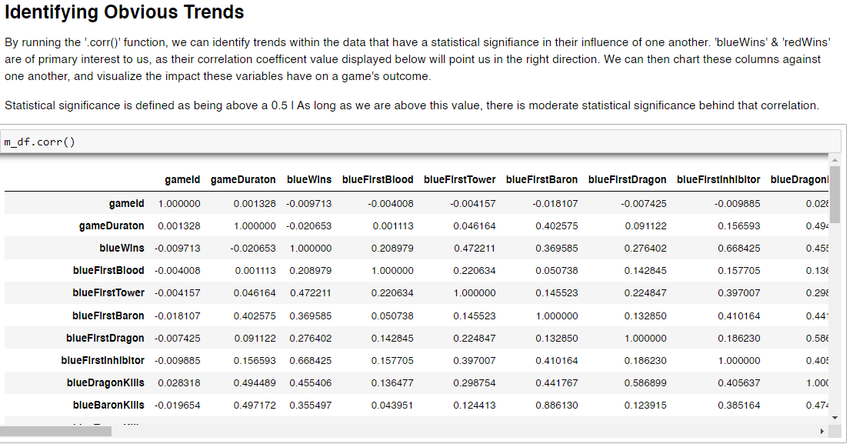
Cleaning - DataFrames
.corr() in action
Frame each time, then frame wins and losses.
Took a while because there are 3 datasets, 2 teams each.

Slide 9
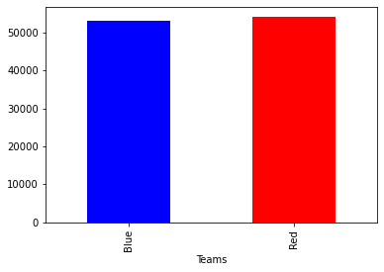

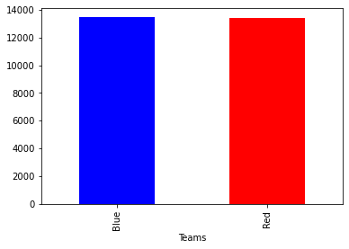
Analysis
Master
Grand Master
Challenger
Percentage of wins for blue is: 0.495%
Percentage of wins for red is: 0.505%
Percentage of wins for blue is: 0.496%
Percentage of wins for red is: 0.504%
Percentage of wins for blue is: 0.50007%
Percentage of wins for red is: 0.49993%

Slide 10
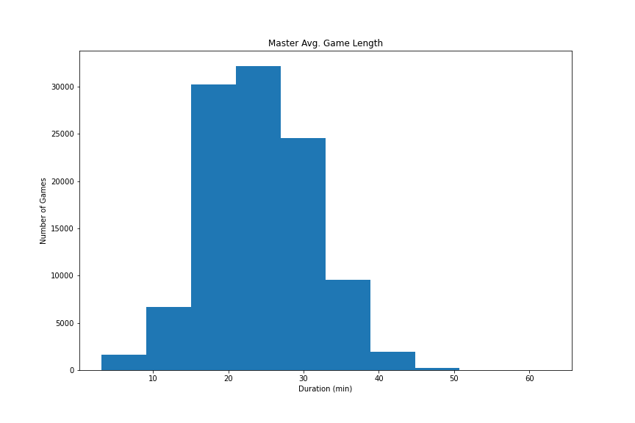
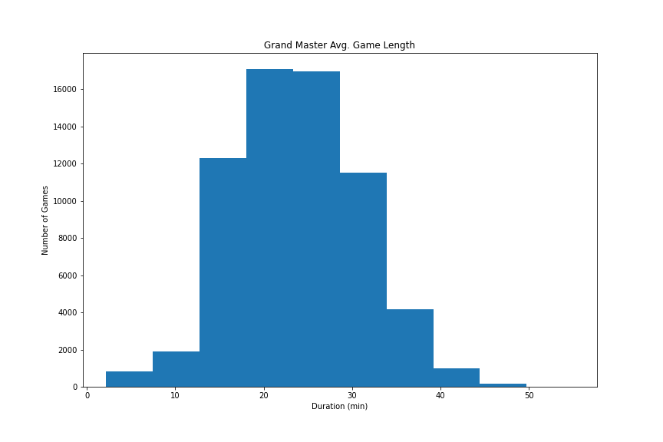
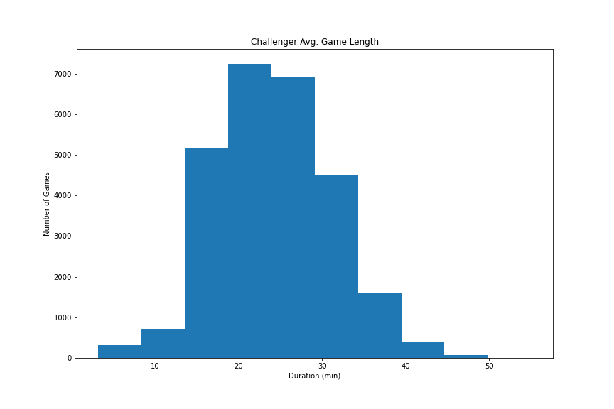
Analysis (Side Question)
Across three ranks, the average game is approx. 24 minutes long.

Slide 11
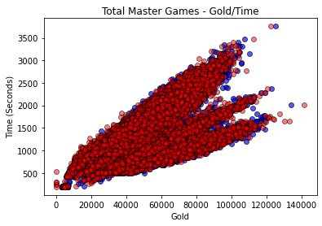
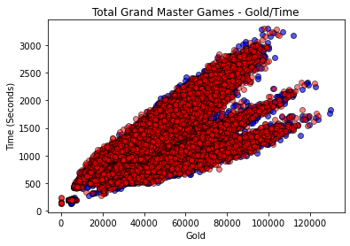
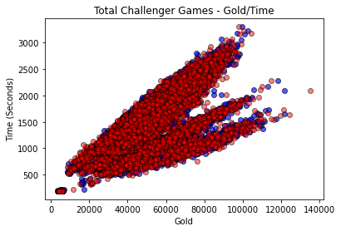
Analysis (Side Question)
Gold doesn’t appear to plateau as game length increases

Slide 12
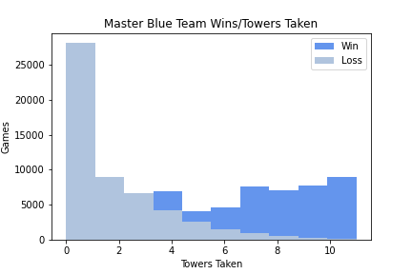
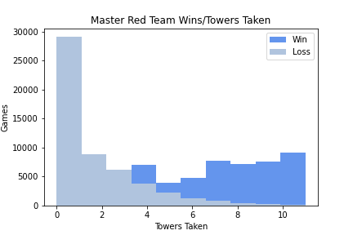
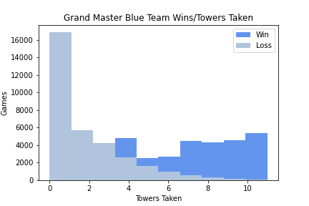
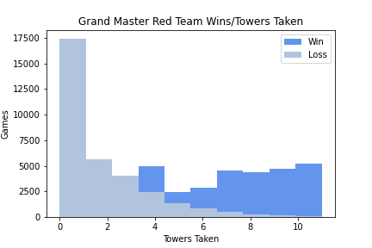
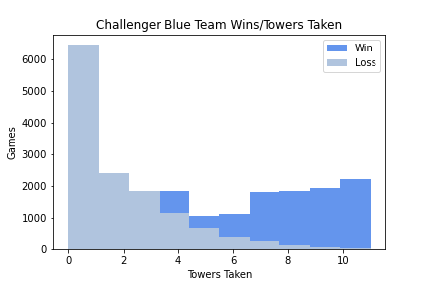
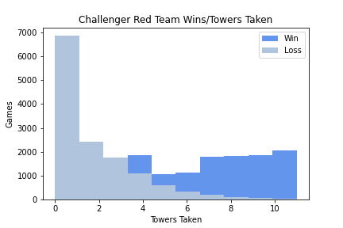
Wins vs. Towers Taken
How do Towers impact games? 0.72 Correlation with winning!
Won games have more towers taken.
Avg. 6.6-6.8 towers taken in won games.

Slide 13
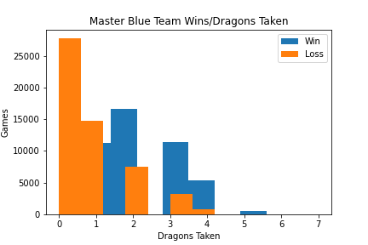
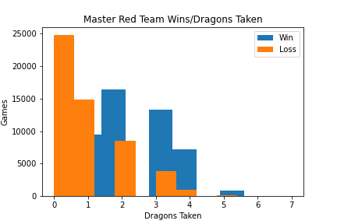
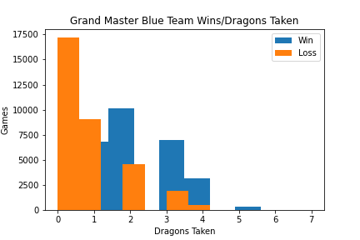
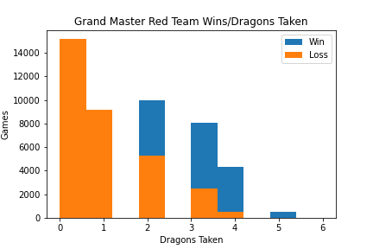

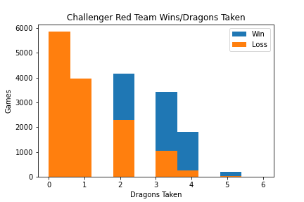
Wins vs. Dragons Taken
How do Dragons, as an objective, impact games won?
Won games have more dragons taken
Doesn’t seem to favor one side

Slide 14
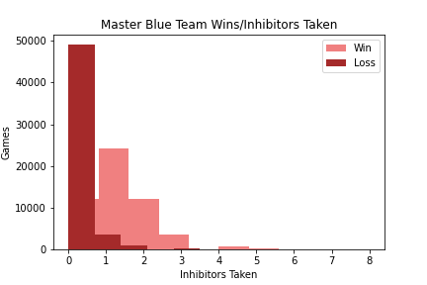
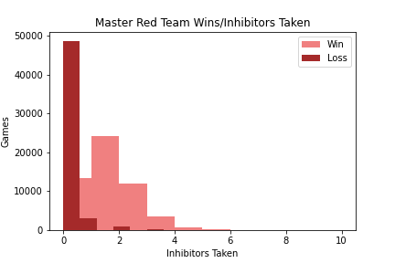
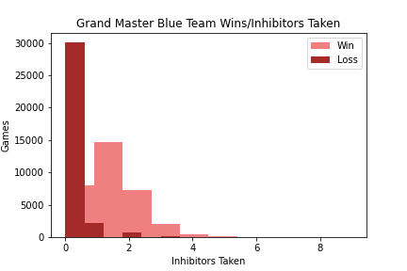

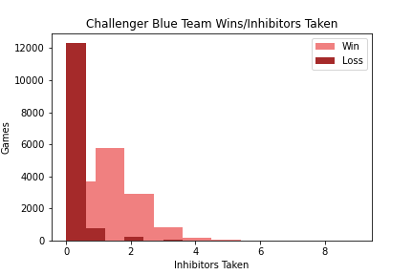
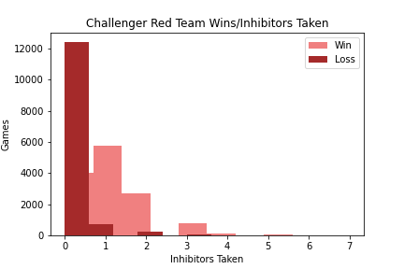
Wins vs. Inhibitors Taken
How do inhibitors taken impact games won?
Won games have more inhibitors taken.
However, 1 is the minimum needed.

Slide 15
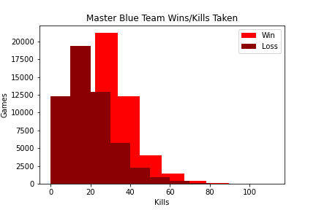
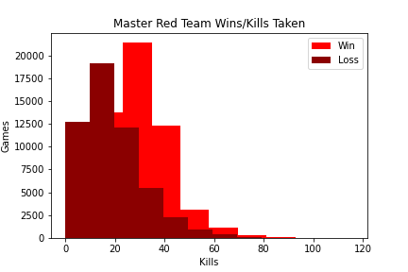
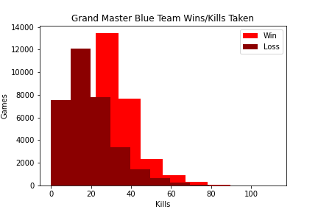
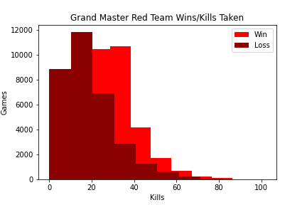
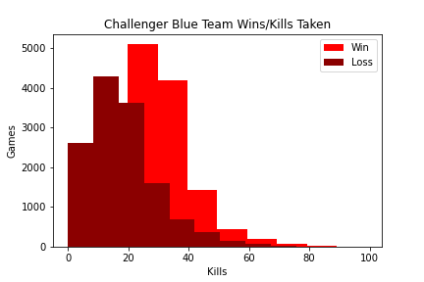
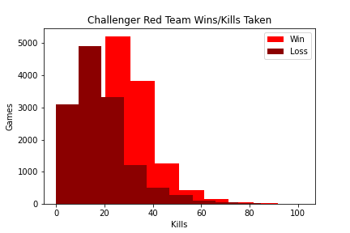
Wins vs. Kills
Teams that won had more kills.

Slide 16
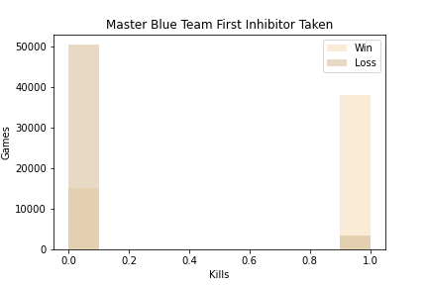
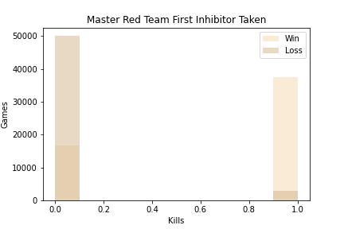
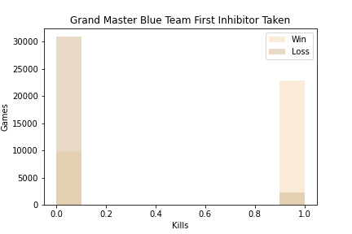
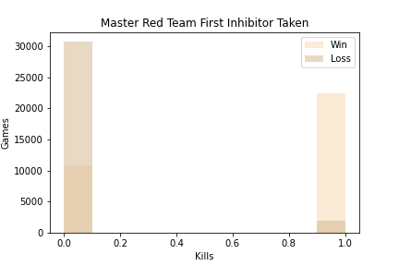
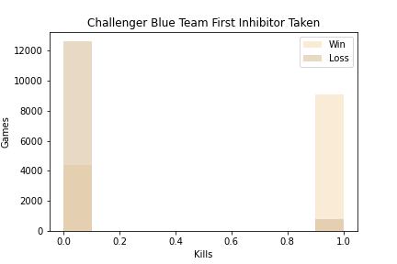
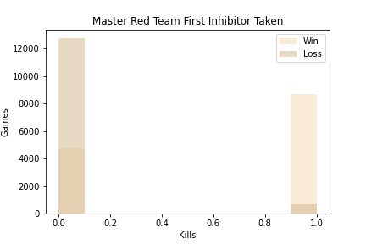
Wins vs. First Inhibitor

Slide 18
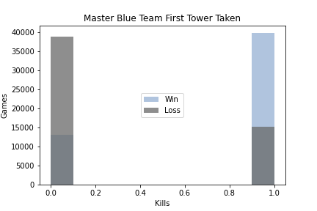
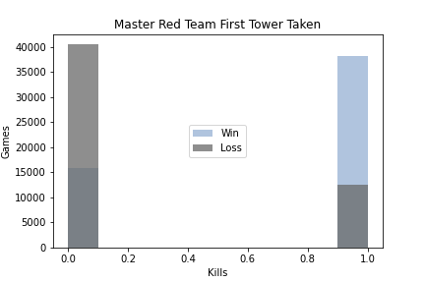
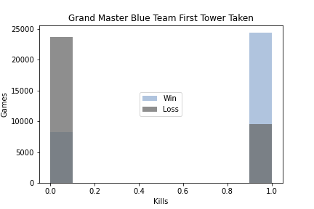
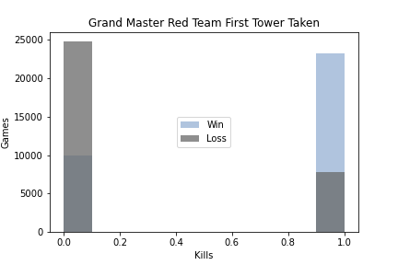
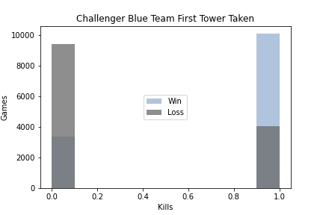
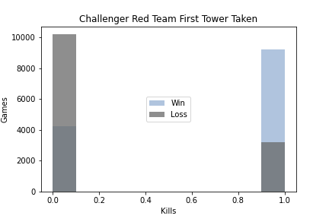
Wins vs. First Tower

Slide 19
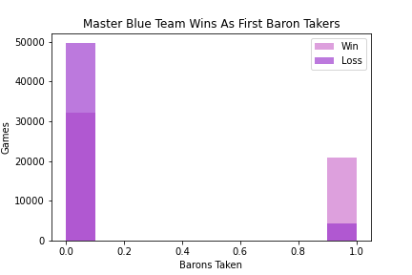





Wins vs. First Baron

Slide 20




Wins vs. First Dragon

Slide 21
Snippets
My favorite function == .corr()

Slide 22

Correlation
.corr() > 0.5

Slide 23

Correlation
.corr() > 0.5

Slide 24

Correlation

Slide 25

Correlation

Slide 26

Snippets
Loop through dictionary and grab anything greater than 0.5

Slide 27

Snippets
How the histograms were made

Slide 28
Limitations / Thoughts
Dataset isn’t particularly large enough to be deciding map balance.
Dataset doesn’t include timespan (How old is this data? Does it span across months or years?).
Originally, I tried the API. Then I tried to use a dataset that was for Data Science, which didn’t work due to it being optimized for tensors.
I Couldn’t get Bar charts to plot for the life of me…
Will work with others next time, to help me think of approaches I wouldn’t have thought of otherwise.

Slide 29
Conclusion
There was no statistical significance between one side winning more than the other.
What DOES matter are objectives. Objectives in the game have the highest statistically significant correlation to a win than any other variable.
If Blue gets a structural objective first, they do appear to win more often (0.05 – 0.06) – Not in a level of statistical significance, but still notable.

Slide 30

Where Next?
Wards/Vision?
Minions Killed?
Gold?

Slide 31
Notebook!

